Slide 1
EM Algorithm
Likelihood, Mixture Models and Clustering

Slide 2
Introduction
In the last class the K-means algorithm for clustering was introduced.
The two steps of K-means: assignment and update appear frequently in data mining tasks.
In fact a whole framework under the title “EM Algorithm” where EM stands for Expectation and Maximization is now a standard part of the data mining toolkit

Slide 3
Outline
What is Likelihood?
Examples of Likelihood estimation?
Information Theory – Jensen Inequality
The EM Algorithm and Derivation
Example of Mixture Estimations
Clustering as a special case of Mixture Modeling

Slide 4
Meta-Idea
Probability
Model
Data
Inference
(Likelihood)
A model of the data generating process gives rise to data.
Model estimation from data is most commonly through Likelihood estimation
From PDM by HMS

Slide 5
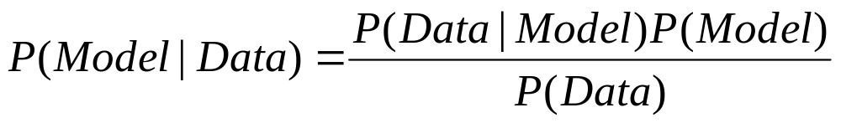
Likelihood Function
Likelihood Function
Find the “best” model which has generated the data. In a likelihood function
the data is considered fixed and one searches for the best model over the
different choices available.

Slide 6
Model Space
The choice of the model space is plentiful but not unlimited.
There is a bit of “art” in selecting the appropriate model space.
Typically the model space is assumed to be a linear combination of known probability distribution functions.

Slide 7
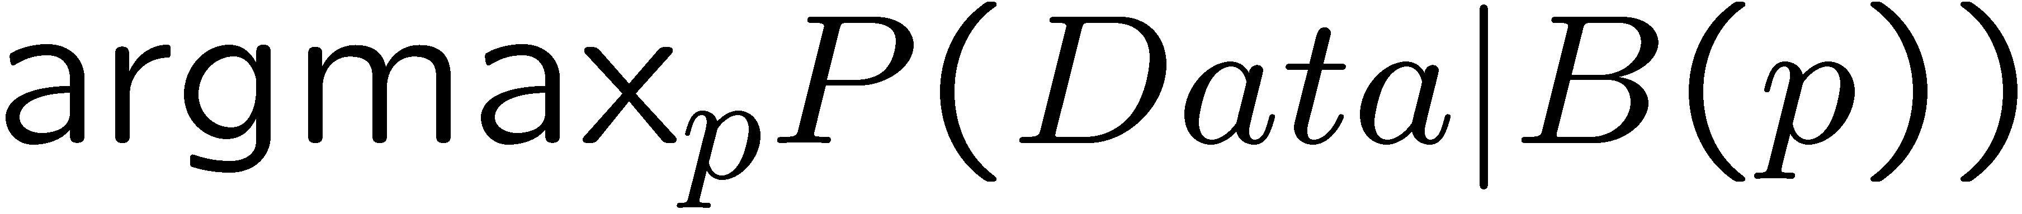
Examples
Suppose we have the following data
  0,1,1,0,0,1,1,0
In this case it is sensible to choose the Bernoulli distribution (B(p)) as the model space.
Now we want to choose the best p, i.e.,

Slide 8
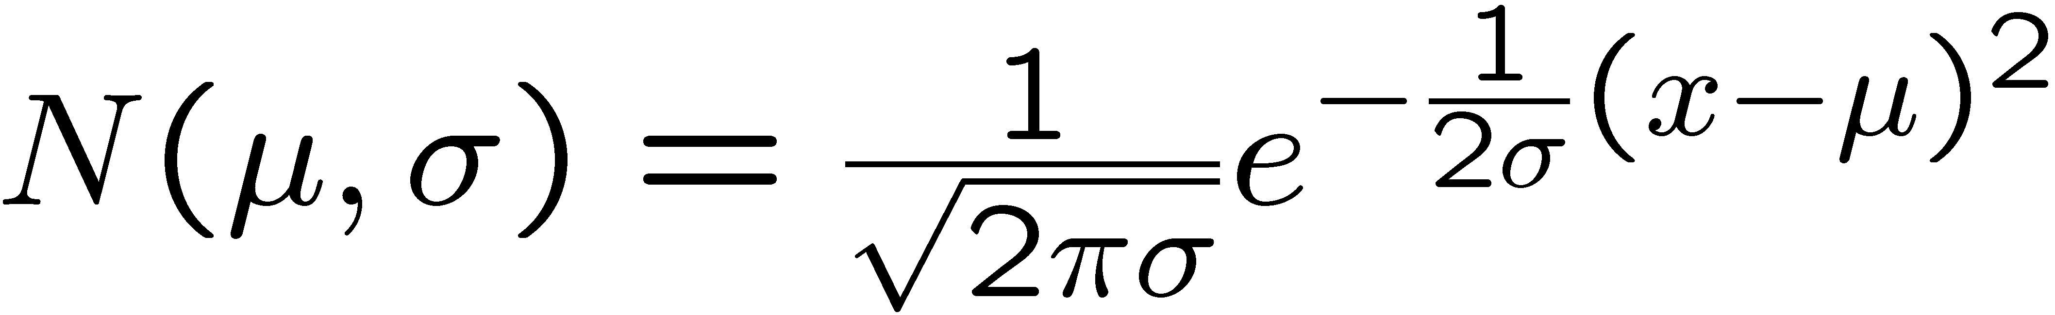
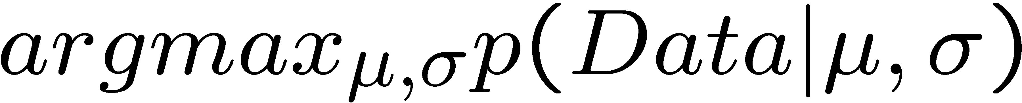
Examples
Suppose the following are marks in a course
55.5, 67, 87, 48, 63
Marks typically follow a Normal distribution whose density function is
Now, we want to find the best μ,σ such that

Slide 9
Examples
Suppose we have data about heights of people (in cm)
  185,140,134,150,170
Heights follow a normal (log normal) distribution but men on average are taller than women. This suggests a mixture of two distributions

Slide 10
Maximum Likelihood Estimation
We have reduced the problem of selecting the best model to that of selecting the best parameter.
We want to select a parameter p which will maximize the probability that the data was generated from the model with the parameter p plugged-in.
The parameter p is called the maximum likelihood estimator.
The maximum of the function can be obtained by setting the derivative of the function ==0 and solving for p.

Slide 11
Two Important Facts
If A₁,…,A_{n} are independent then
The log function is monotonically increasing. x · y ! Log(x) · Log(y)
Therefore if a function f(x) >= 0, achieves a maximum at x1, then log(f(x)) also achieves a maximum at x1.

Slide 12
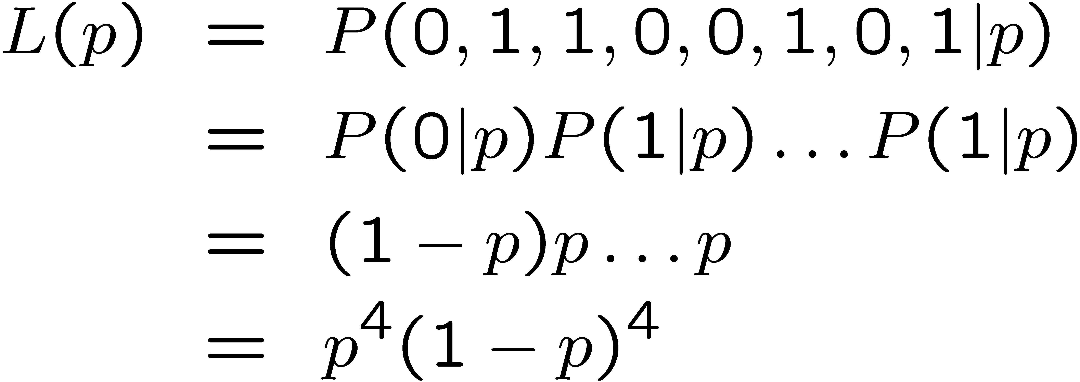
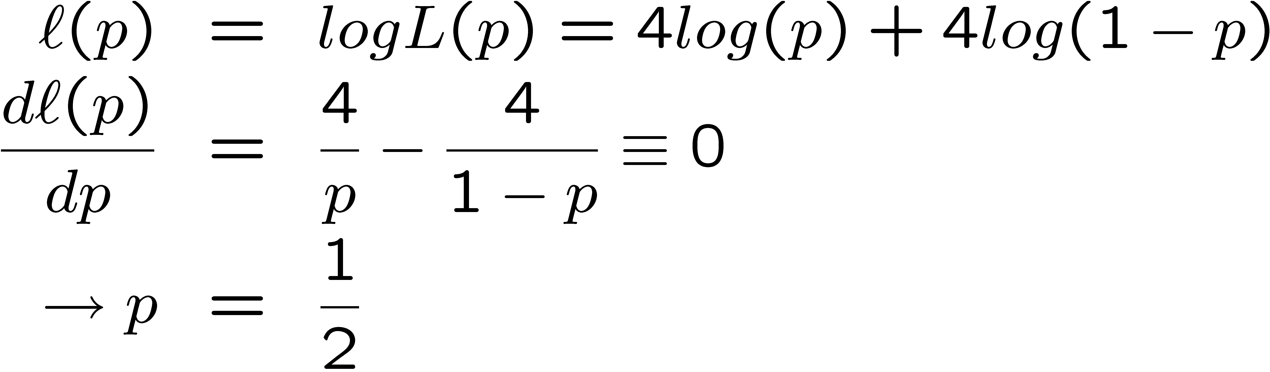
Example of MLE
Now, choose p which maximizes L(p). Instead we will maximize l(p)= LogL(p)

Slide 13
Properties of MLE
There are several technical properties of the estimator but lets look at the most intuitive one:
  As the number of data points increase we become more sure about the parameter p

Slide 14
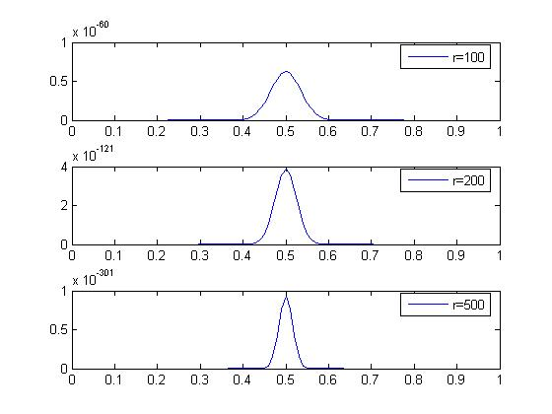
Properties of MLE
r is the number of data points. As the number of data points increase the
confidence of the estimator increases.

Slide 15
Matlab commands
[phat,ci]=mle(Data,’distribution’,’Bernoulli’);
[phi,ci]=mle(Data,’distribution’,’Normal’);

Slide 16
MLE for Mixture Distributions
When we proceed to calculate the MLE for a mixture, the presence of the sum of the distributions prevents a “neat” factorization using the log function.
A completely new rethink is required to estimate the parameter.
The new rethink also provides a solution to the clustering problem.

Slide 17
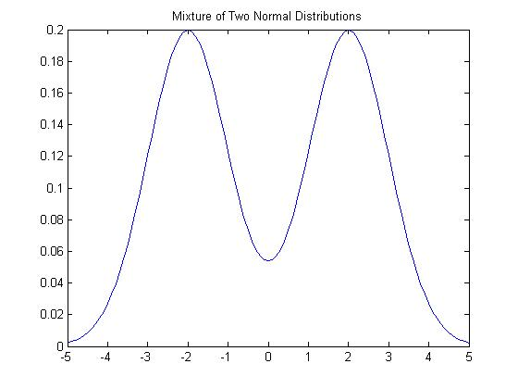
A Mixture Distribution

Slide 18
Missing Data
We think of clustering as a problem of estimating missing data.
The missing data are the cluster labels.
Clustering is only one example of a missing data problem. Several other problems can be formulated as missing data problems.

Slide 19
Missing Data Problem
Let D = {x(1),x(2),…x(n)} be a set of n observations.
Let H = {z(1),z(2),..z(n)} be a set of n values of a hidden variable Z.
  z(i) corresponds to x(i)
Assume Z is discrete.

Slide 20
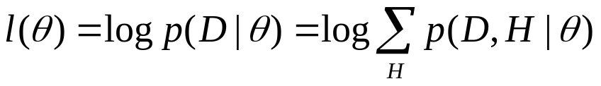
EM Algorithm
The log-likelihood of the observed data is
Not only do we have to estimate θ but also H
Let Q(H) be the probability distribution on the missing data.

Slide 21
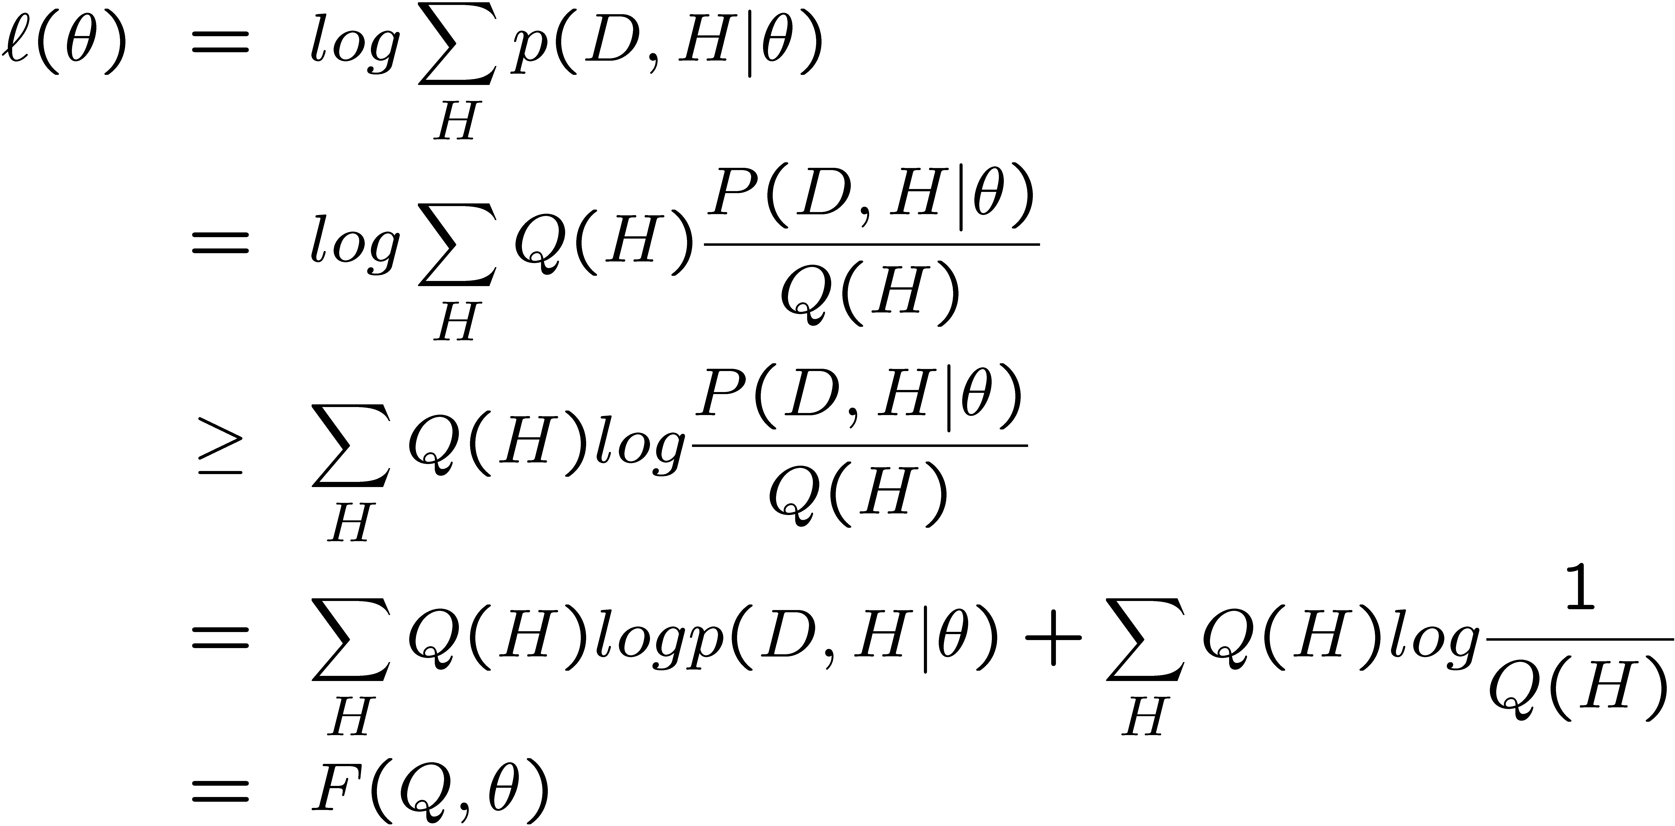
EM Algorithm
Inequality is because of Jensen’s Inequality.
This means that the F(Q,θ) is a lower bound on l(θ)
Notice that the log of sums is become a sum of logs

Slide 22
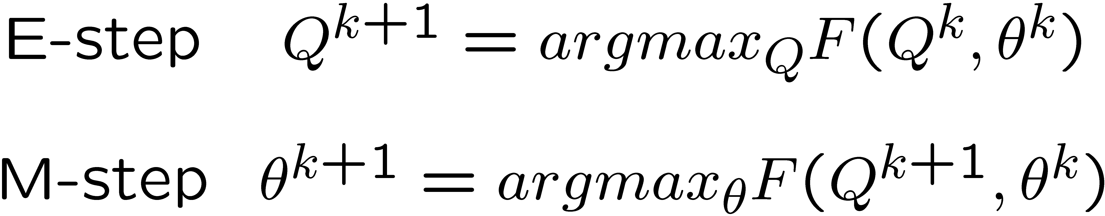
EM Algorithm
The EM Algorithm alternates between maximizing F with respect to Q (theta fixed) and then maximizing F with respect to theta (Q fixed).

Slide 23
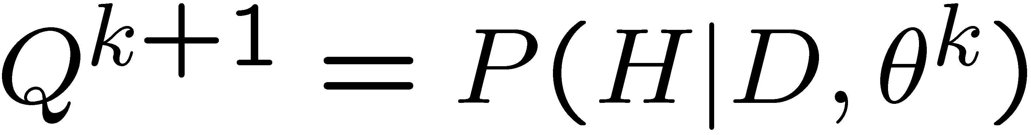
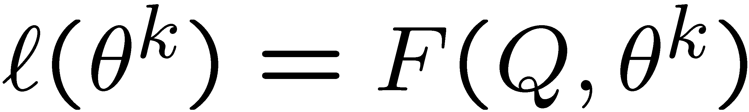
EM Algorithm
It turns out that the E-step is just
And, furthermore
Just plug-in

Slide 24
EM Algorithm
The M-step reduces to maximizing the first term with respect to θ as there is no θ in the second term.

Slide 25
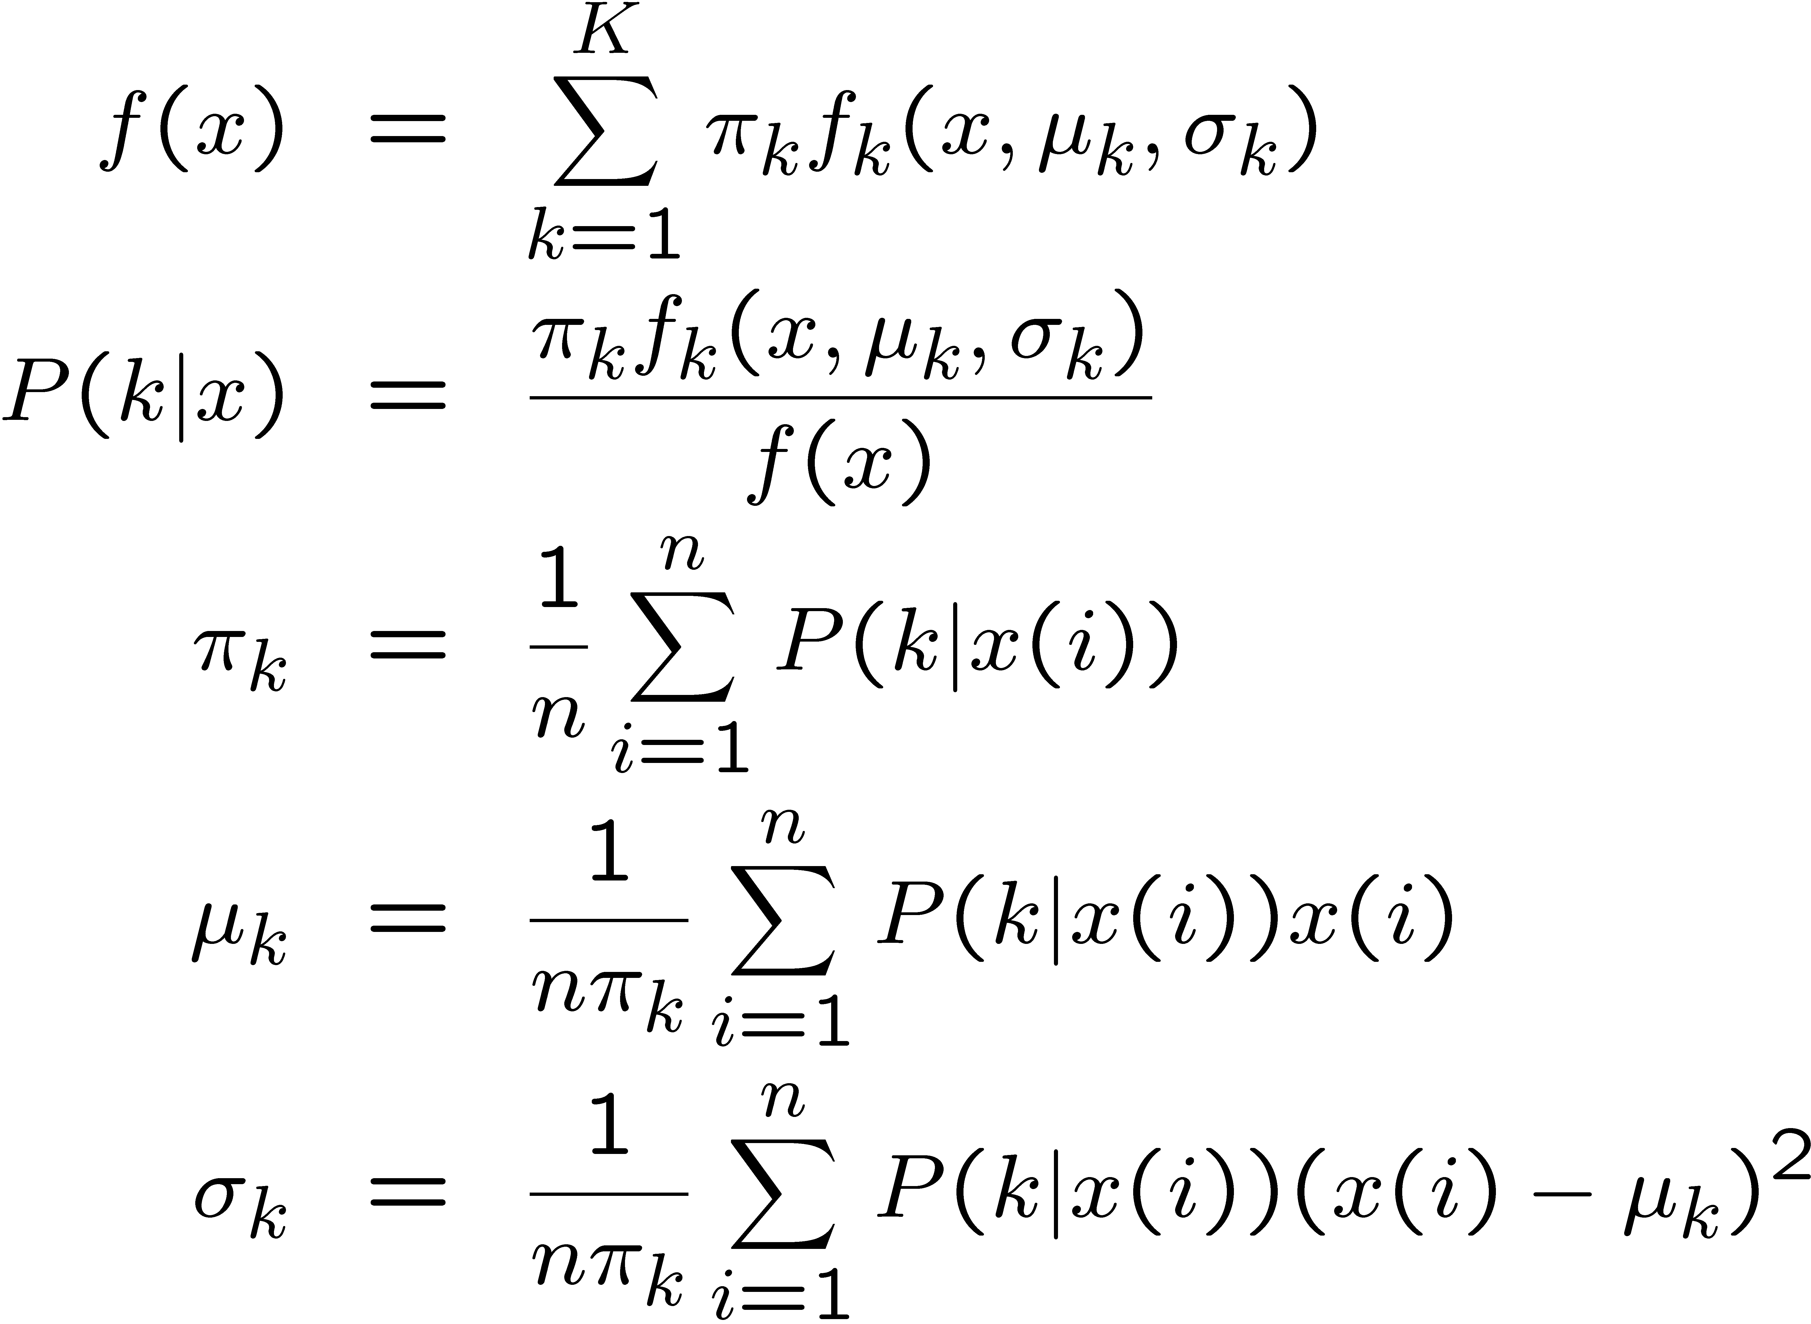
EM Algorithm for Mixture of Normals
Mixture of
Normals
E Step
M-Step

Slide 26
EM and K-means
Notice the similarity between EM for Normal mixtures and K-means.
The expectation step is the assignment.
The maximization step is the update of centers.

